Slide 1


DESIGN 1
Lesson 3: Independent Application: Visual Storytelling
Ms. Abboud • Grade 9 - Design 1 • Term 1, Week 6

Slide 2
Learning Objectives
WALT - We Are Learning To
WILF - What I'm Looking For
Independently select images that support my site's content.
Keep the images/ folder organized.
New image choice is clearly relevant to its section.
Image folder stays organized (no stray files outside images/).

Slide 3
Frayer Model: Image Tag (img) (Review)
DEFINITION
CHARACTERISTICS
The self-closing <img> tag used to embed a picture in a webpage.
Self-closing; needs src and alt; no closing tag.
IMAGE TAG (IMG)
EXAMPLES
NON-EXAMPLES
<img src="photo.jpg" alt="My photo">.
<a>; <p> (these need closing tags).

Slide 4
National Identity Integration
UAE Landmarks and Tourism: choosing images that genuinely represent a place or topic, not just decoration, the way a tourism site chooses photos that tell a real story.

Slide 5
STARTER
Where Would an Image Help?
Where on your site would an image actually help communicate something, not just decorate the page?
Hook • Engage & Ask
5 - 10 minutes

Slide 6
LESSON CORE
I Do: Today's Challenge
Identify 1-2 more spots where an image would genuinely support your content.
Stretch: wrap an image inside a link (<a><img></a>) so clicking it navigates somewhere.
Gradual Release of Responsibility
30 - 40 minutes
Example: an image wrapped in a link
<a href="about.html">
<img src="images/thumbnail.jpg" alt="Click to visit my About page" width="150">
</a>
1 / 2

Slide 7
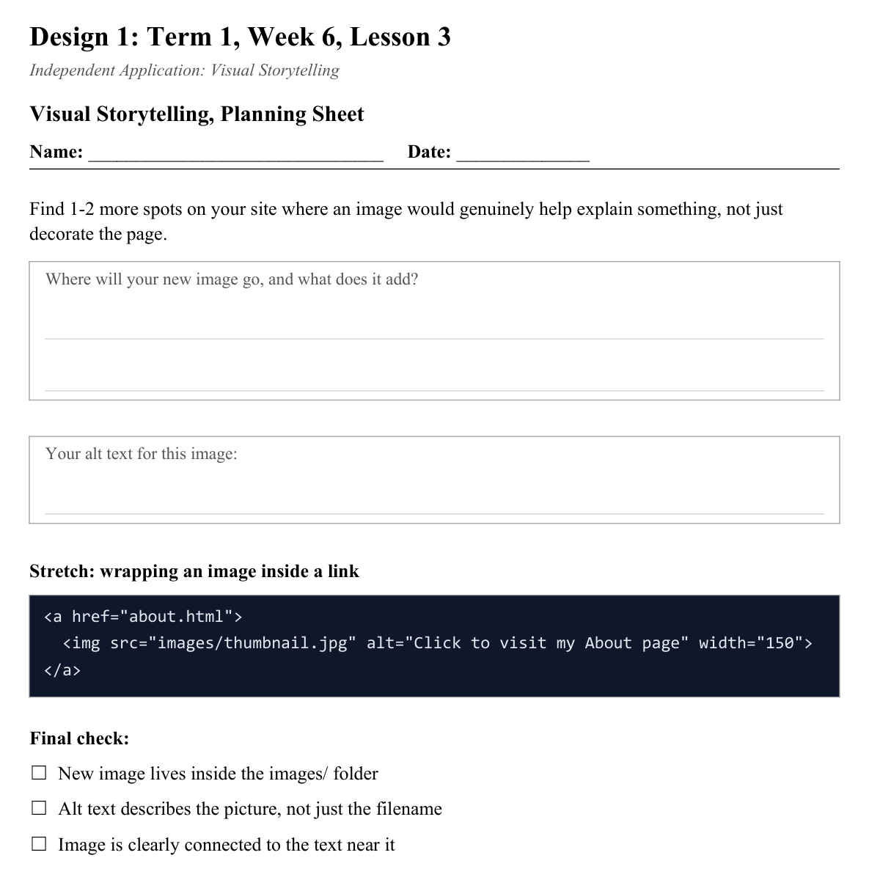
LESSON CORE
You Do: Add & Organize
Source, insert, and describe your new image(s) with correct sizing and alt text.
Keep every image file inside images/ - nothing stray.
Activity: Visual Storytelling, Planning Sheet
Gradual Release of Responsibility
30 - 40 minutes
2 / 2

Slide 8
CLOSURE
Teacher Circulation
No formal exit ticket today. Teacher circulates for 1:1 feedback on visual choices.
Transition & Extend
5 - 10 minutes

